Slide 1

Core Standards, Expectations and Rewards

Slide 2

Core Standards
Compassion
We focus on the positives
Ambition
We challenge ourselves to go further
Partnership
We are better when we work together

Slide 3
Student Expectations
Ready
Attend School
Wear school uniform
Be where you should be, at the right time
Have everything you need to learn
Respect
Listen to others
Respect others opinions, culture and beliefs
Be respectful with the words we use
Acknowledge your own, and others achievements
Safe
Listen to staff instruction
Stay in the area you should be
Keep yourself and others safe from harm
Keep your environment tidy
Inform staff of hazards

Slide 4
Rewards at Venture
DOJO’s

Slide 5
Introducing Class DOJO
DOJO is:
Students can work as a class towards a common goal e.g. half termly trip
Students can see their own DOJO points
Parents can see their child’s DOJO points

Slide 6
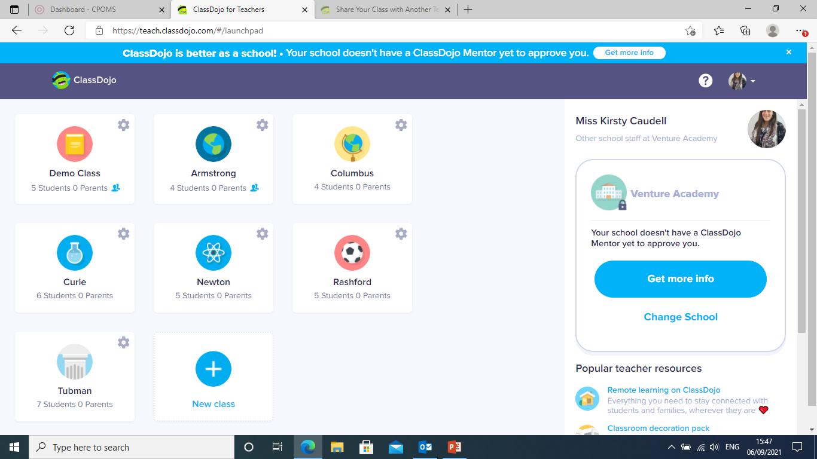
Class Dojo

Slide 7
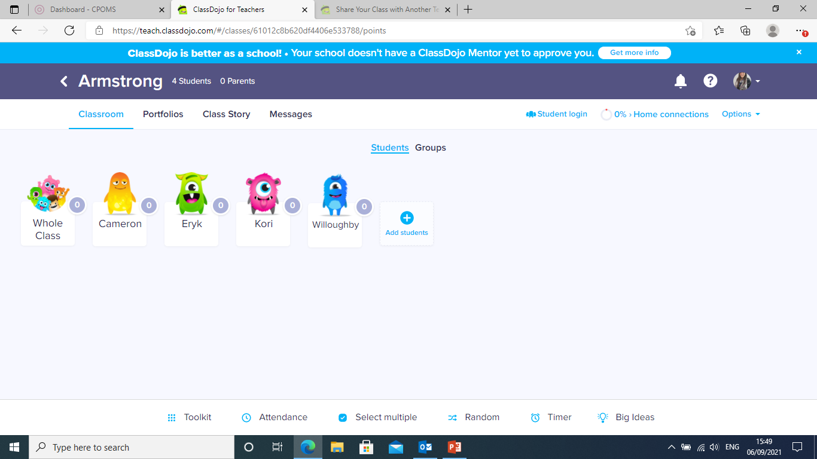
Each Class

Slide 8
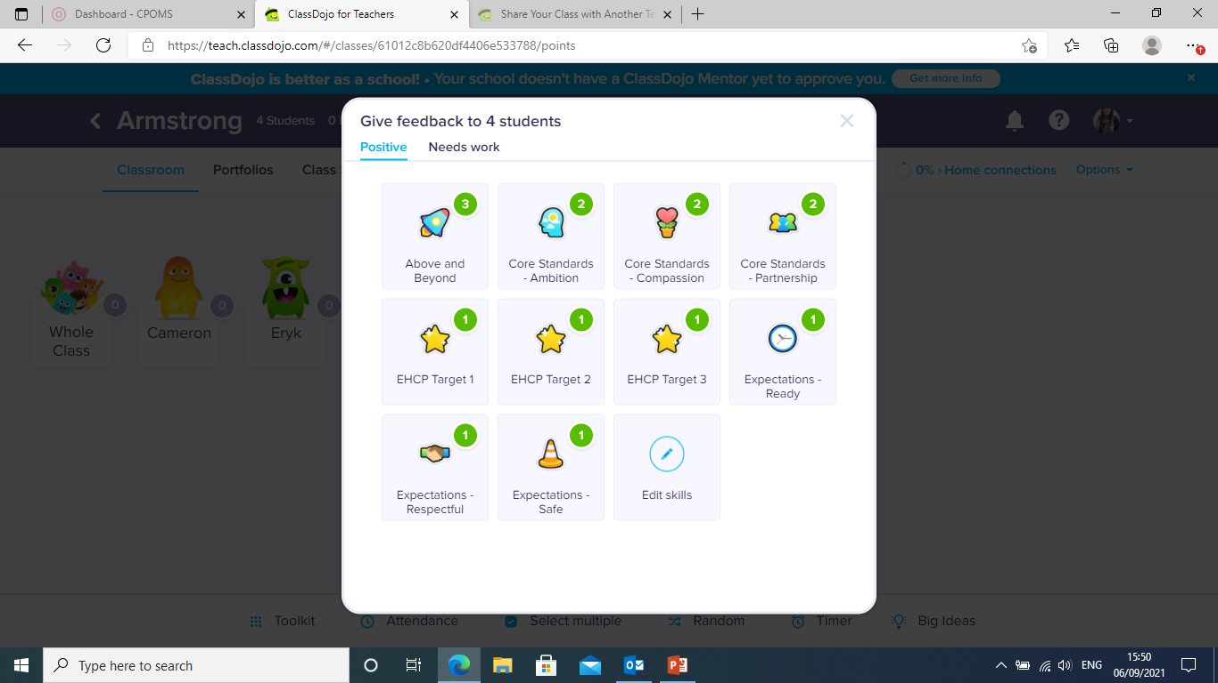
Whole class Dojos

Slide 9
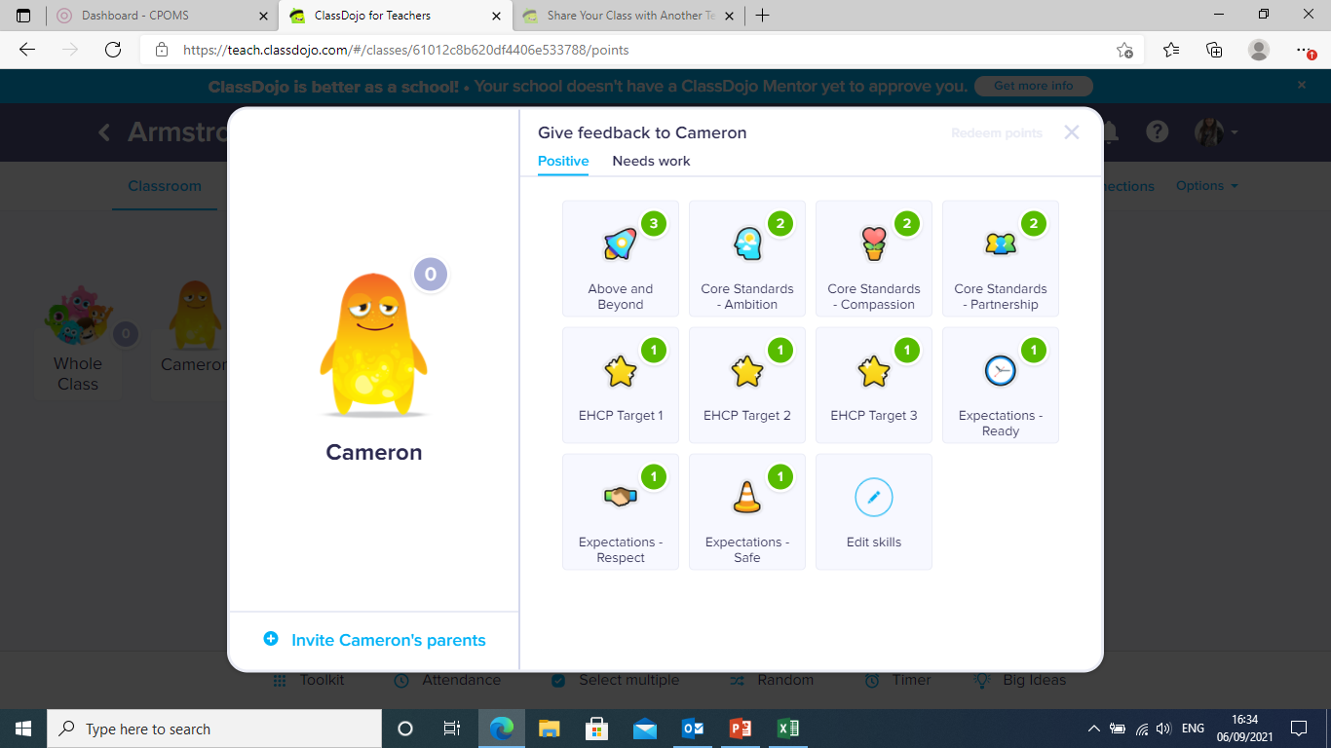
Individual Dojos

Slide 10
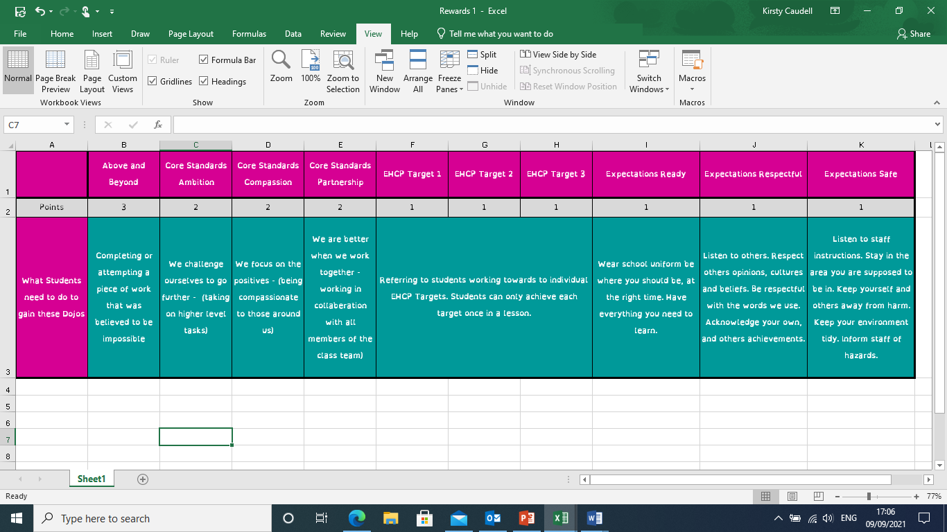
Reward Categories

Slide 11
Reward Categories

Slide 12
Reward Categories

Slide 13
Reward Categories

