Slide 1

Welcome to
Venture Academy
Online Payment Service

Slide 2






ParentPay
ParentPay is our secure online income collection and management service.
ParentPay allows you to make payments to school using your debit/credit card or in cash using ParentPay top-up card at your local PayPoint outlets. You can make payments for:
school meals
trips
before/after school clubs and other items.

Slide 3
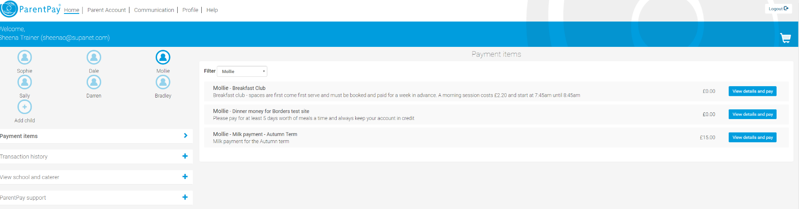
How does it work?
The school set up payment items and assign them to the relevant children…this then appears in the payers account for you to pay.

Slide 4
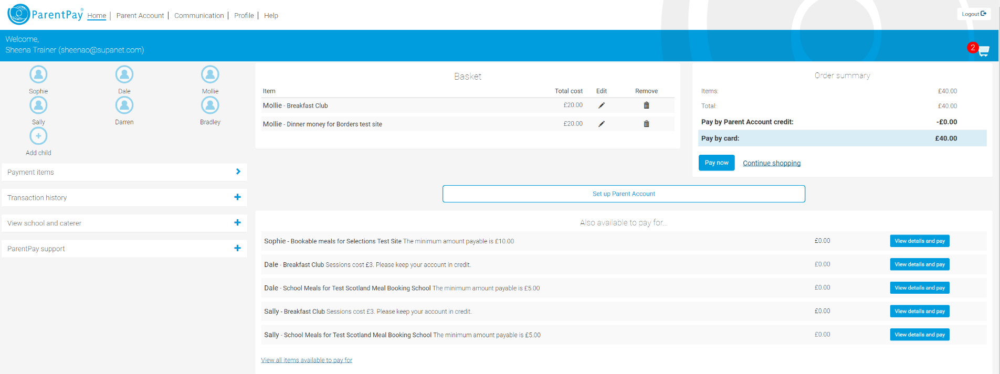
How does it work?
Once the item has been added, you will be able to make a payment online via ParentPay or with cash at your local PayPoint store

Slide 5
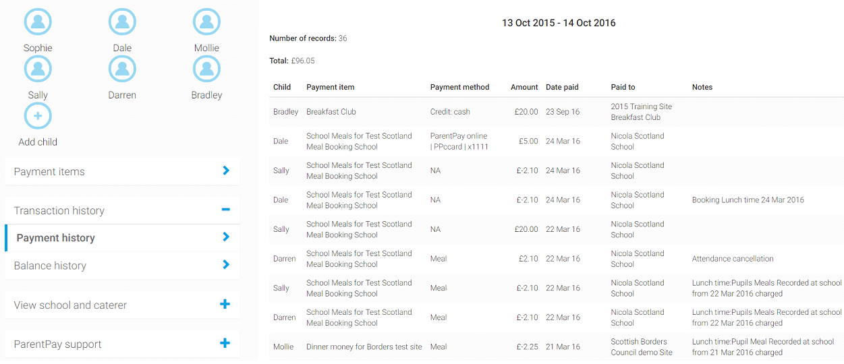
How do you keep track?
You can keep track of your payments, balances and purchases at any time using the views and reports.

Slide 6
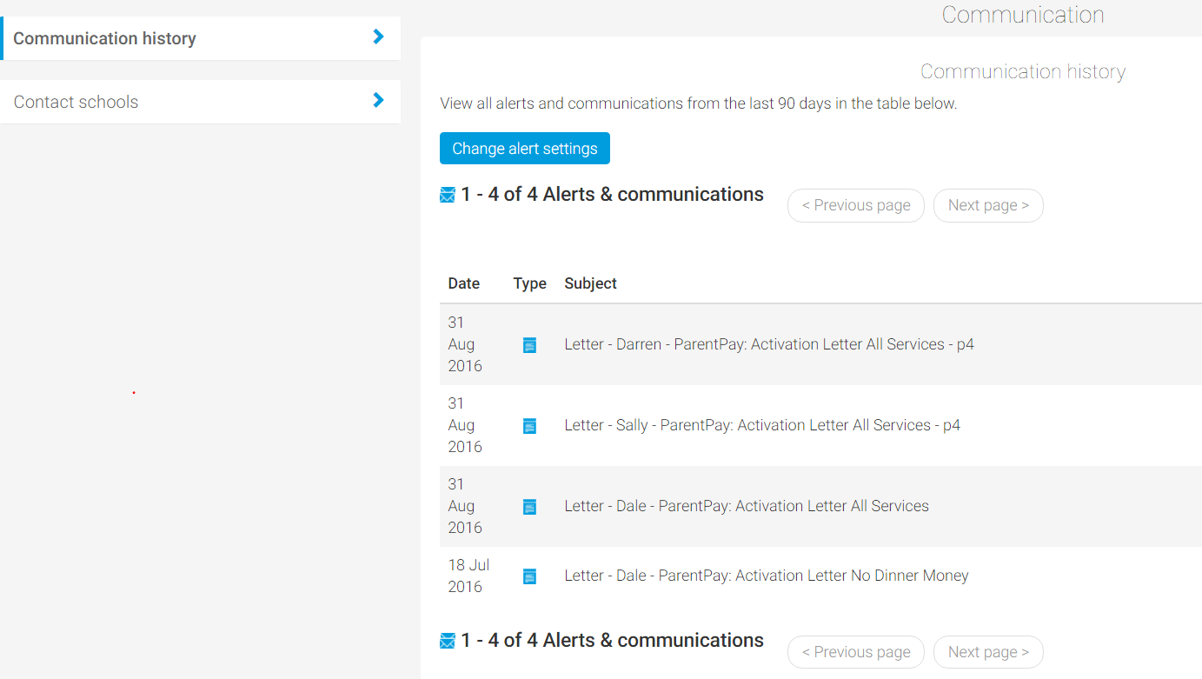
Don’t miss out! Keep updated…
You are able to set your account to receive automated alerts
The school are able to send communication to you via email, SMS or letter.

Slide 7
Why we need you to help us go cashless
Our vision is to create a fully cashless school; helping us to continue to offer a safe, secure environment whilst better enabling us to support teaching and learning. ParentPay also helps you to:
keep your children safe and minimises lost payments
pay for items in a flexible and secure manner
manage your payments simply, providing peace of mind
keep up to date with payment and balance alerts via email/SMS

Slide 8
Making life easier for you
Paying by ParentPay helps our school enormously, whilst providing you with a more secure way to make payments.
Hundreds of thousands of parents are using ParentPay
everyday, make sure you are one of them.
Thank you for your support!

Slide 9
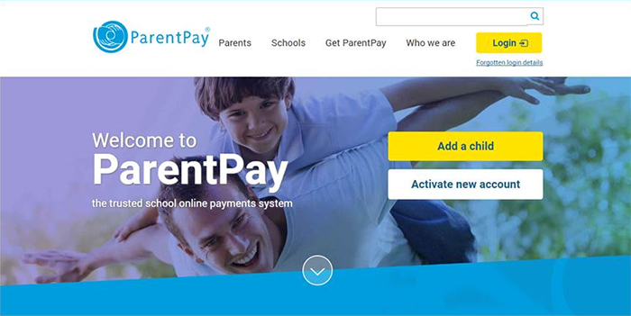
Thank you, any questions?

